Slide 1
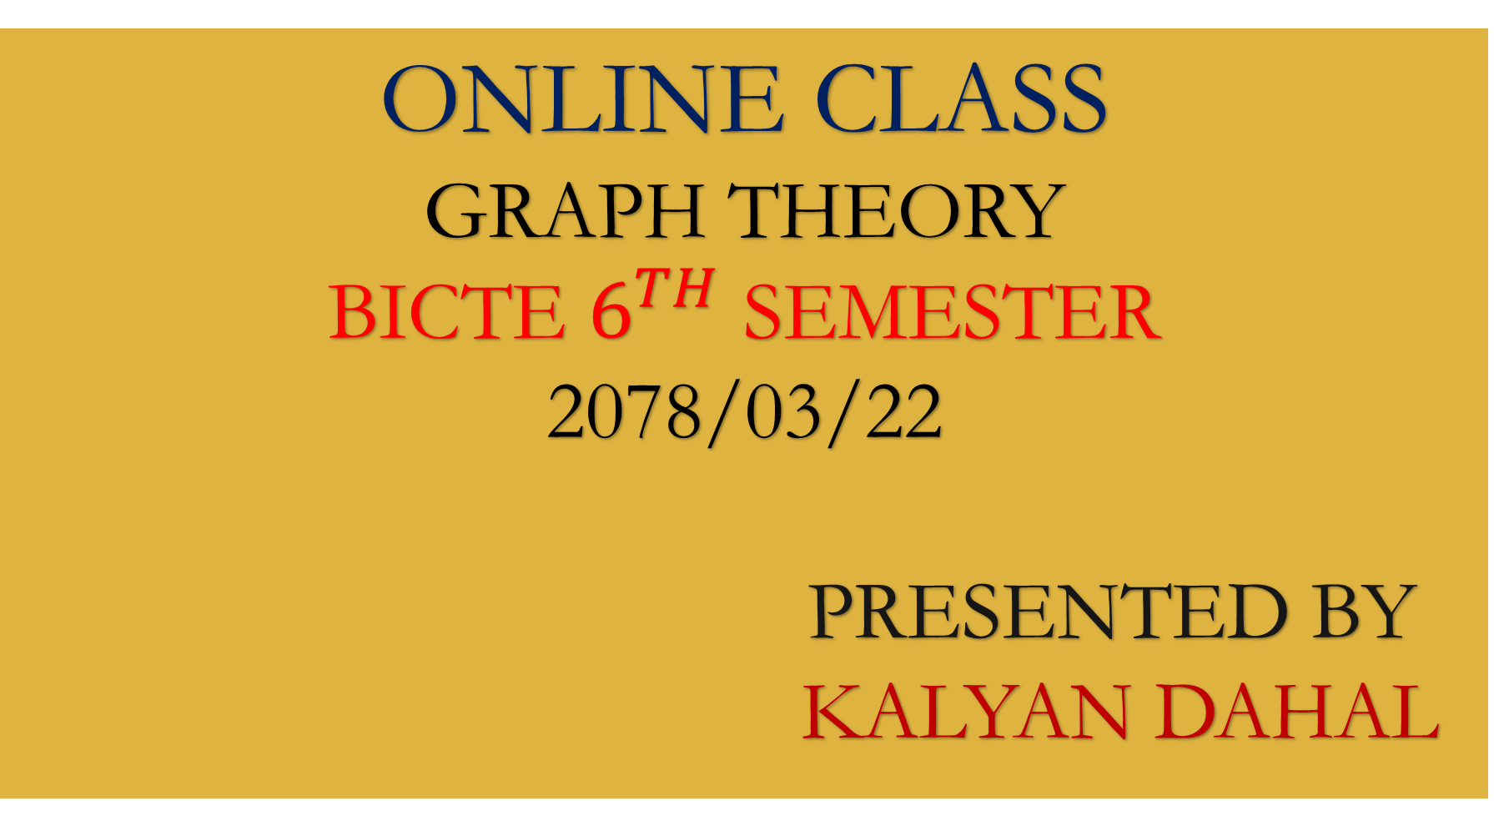
ONLINE CLASS
GRAPH THEORY
BICTE $6^{TH}$ SEMESTER
2078/03/22
PRESENTED BY KALYAN DAHAL

Slide 2
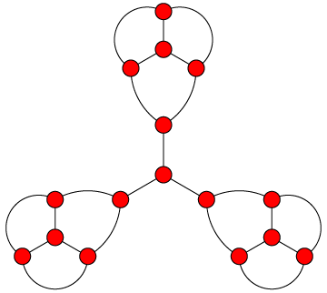
Regular graph which is not perfect matching

Slide 3
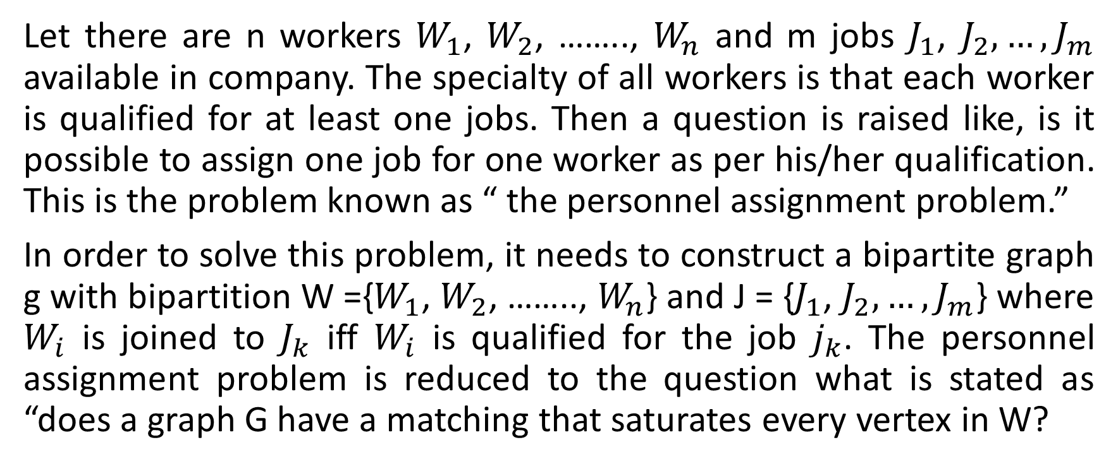
The personnel assignment problem
Let there are n workers $W_{1}$, $W_{2}$, …….., $W_{n}$ and m jobs $J_{1}$, $J_{2}, …,J_{m}$ available in company. The specialty of all workers is that each worker is qualified for at least one jobs. Then a question is raised like, is it possible to assign one job for one worker as per his/her qualification. This is the problem known as “ the personnel assignment problem.”
In order to solve this problem, it needs to construct a bipartite graph g with bipartition W ={$W_{1}$, $W_{2}$, …….., $W_{n}$} and J = {$J_{1}$, $J_{2}, …,J_{m}$} where $W_{i}$ is joined to $J_{k}$ iff $W_{i}$ is qualified for the job $j_{k}$. The personnel assignment problem is reduced to the question what is stated as “does a graph G have a matching that saturates every vertex in W?

Slide 4
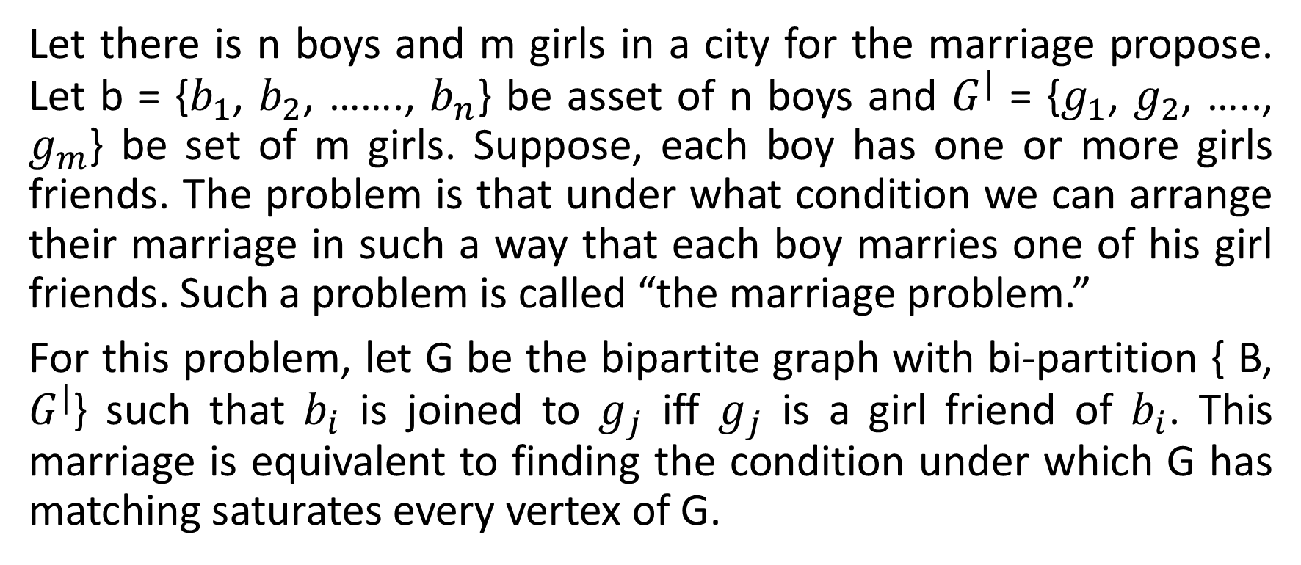
The marriage problem
Let there is n boys and m girls in a city for the marriage propose. Let b = {$b_{1}$, $b_{2}$, ……., $b_{n}$} be asset of n boys and $G^{|}$ = {$g_{1}$, $g_{2}$, ….., $g_{m}$} be set of m girls. Suppose, each boy has one or more girls friends. The problem is that under what condition we can arrange their marriage in such a way that each boy marries one of his girl friends. Such a problem is called “the marriage problem.”
For this problem, let G be the bipartite graph with bi-partition { B, $G^{|}$} such that $b_{i}$ is joined to $g_{j}$ iff $g_{j}$ is a girl friend of $b_{i}$. This marriage is equivalent to finding the condition under which G has matching saturates every vertex of G.

Slide 5
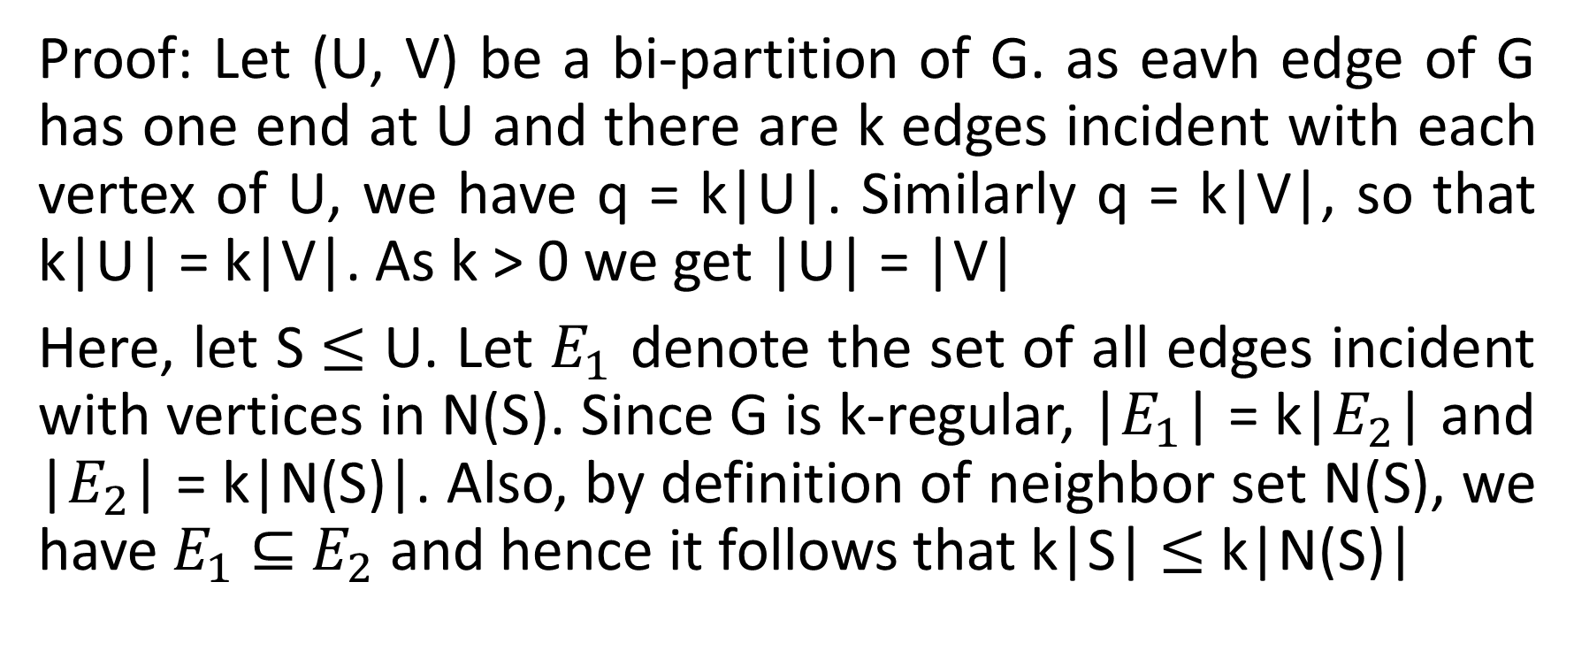
Let G be a k-regular bipartite graph with k > 0. Then G has a perfect matching.
Proof: Let (U, V) be a bi-partition of G. as eavh edge of G has one end at U and there are k edges incident with each vertex of U, we have q = k|U|. Similarly q = k|V|, so that k|U| = k|V|. As k > 0 we get |U| = |V|
Here, let S $≤$ U. Let $E_{1}$ denote the set of all edges incident with vertices in N(S). Since G is k-regular, |$E_{1}$| = k|$E_{2}$| and |$E_{2}$| = k|N(S)|. Also, by definition of neighbor set N(S), we have $E_{1}$ $⊆$ $E_{2}$ and hence it follows that k|S| $≤$ k|N(S)|

Slide 6
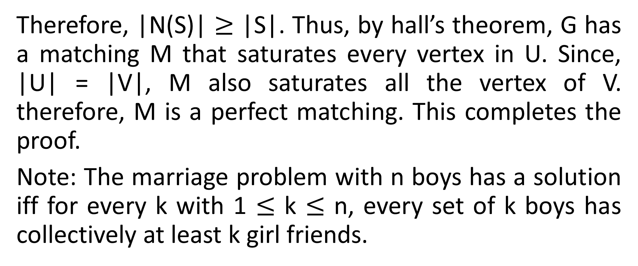
Continued….
Therefore, |N(S)| $≥$ |S|. Thus, by hall’s theorem, G has a matching M that saturates every vertex in U. Since, |U| = |V|, M also saturates all the vertex of V. therefore, M is a perfect matching. This completes the proof.
Note: The marriage problem with n boys has a solution iff for every k with 1 $≤$ k $≤$ n, every set of k boys has collectively at least k girl friends.

Slide 7
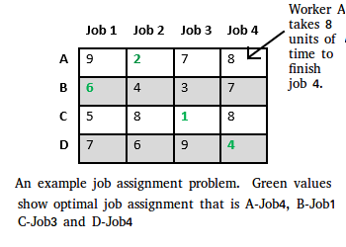
2

Slide 8
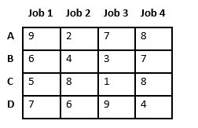
Let’s take below example and try to calculate promising cost when Job 2 is assigned to worker A.

Slide 9
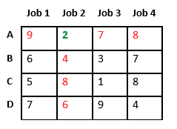
Since Job 2 is assigned to worker A (marked in green), cost becomes 2 and Job 2 and worker A becomes unavailable (marked in red)

Slide 10
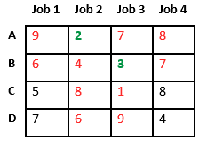
Now we assign job 3 to worker B as it has minimum cost from list of unassigned jobs. Cost becomes 2 + 3 = 5 and Job 3 and worker B also becomes unavailable.

Slide 11
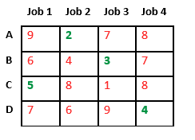
Finally, job 1 gets assigned to worker C as it has minimum cost among unassigned jobs and job 4 gets assigned to worker C as it is only Job left. Total cost becomes 2 + 3 + 5 + 4 = 14.

Slide 12
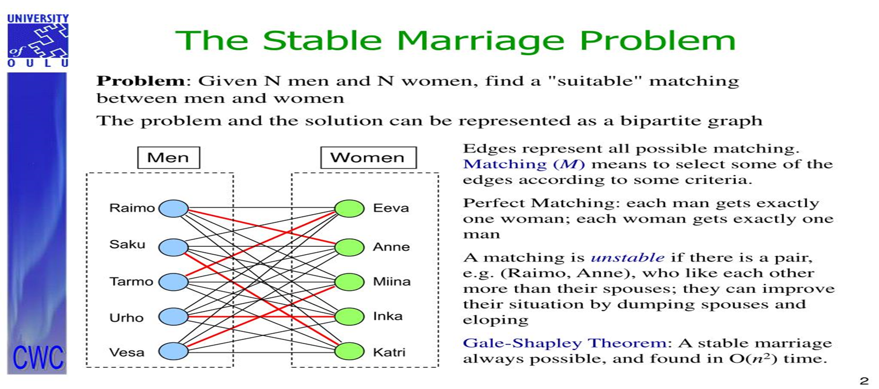

Slide 13
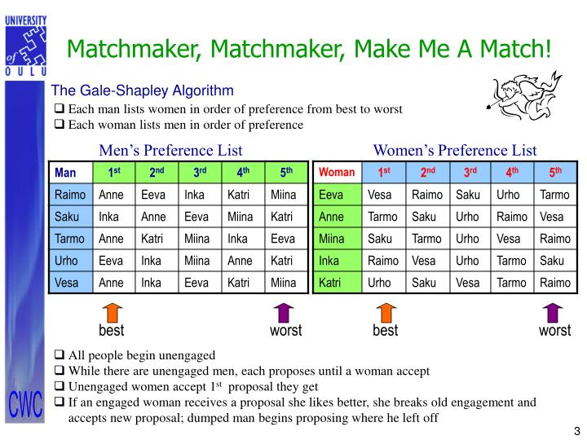

Slide 14
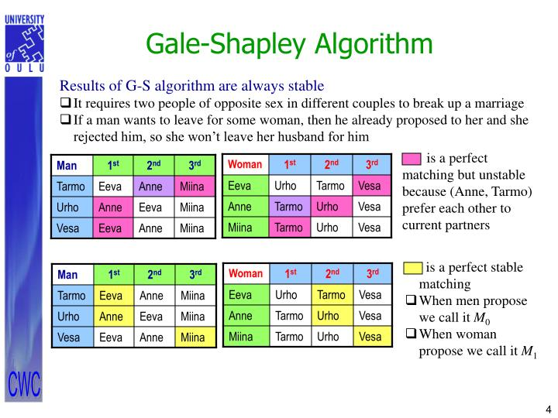

Slide 15
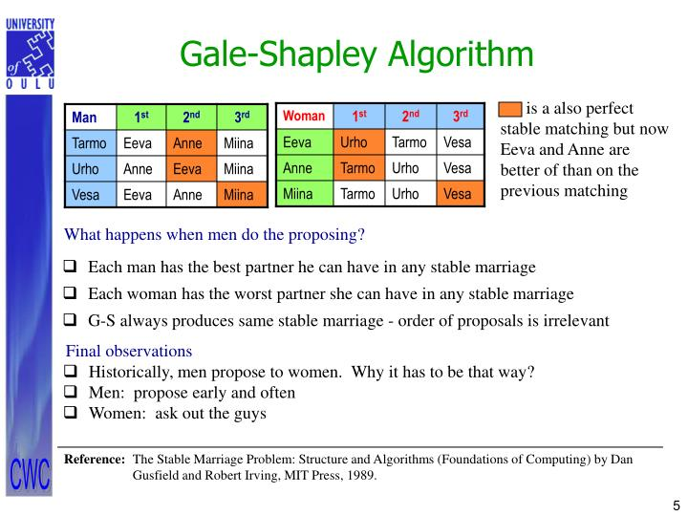

Slide 16
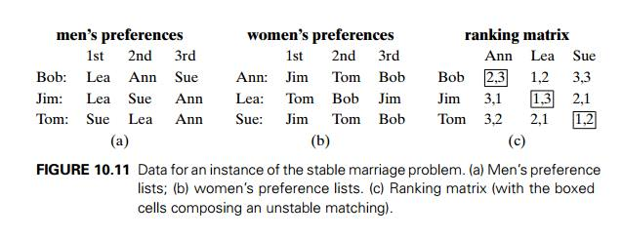

Slide 17
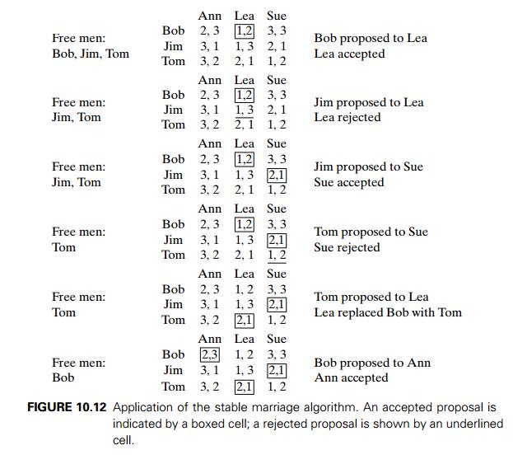

Slide 18


